Slide 1

Introduction to AI, Spring 2023 Adversarial Search

Slide 2
Brief Recap
Last time, we talked about informed search!
What did we mean by that?

Slide 3
Brief Recap
Informed search considers more than just the problem description when choosing states.
E.g., when presented with multiple states to expand…
It will pick one based on how “good” it is
e.g., how close that state is to a goal state.
The estimate for how much work remains is called the heuristic.
In other words, a measure of “how promising” a state is.
Notes:
The estimate for how much work remains (e.g., how “far away” we are from reaching a goal state).

Slide 4
Heuristics Recap
Sample heuristic: Straight Line Distance
Don’t feel “bound” to the roads!
Straightest distance between two points is a straight line!
Sample Heuristic: Manhattan Distance
“The difference in X coordinates + the difference in Y coordinates”
Ignores obstacles!
A
B
C
D
E
F
G
H
I
J
K
L
M
N
O
P
Q
R
S
T
U
Notes:
Although the notion of a heuristic remains the same: a measure of how much work remains from any given state to a goal state, the specific heuristic that you use will change from problem to problem!
We chatted about a few different heuristics across a few different problems – with our Romanian map we introduced the “straight line heuristic” – “As the crow flies” between two cities.
We also talked about the Manhattan distance, which is really useful to have in your pocket when you are working with grid based worlds. You can only move in straight lines, but you can ignore obstacles. It’s just the sum of the difference of the x coordinates and y coordinates.

Slide 5
Best-First Search Recap
Best-First search is a type of informed search that leverages this heuristic value.
Greedy Search: *Only* considers the heuristic value.
i.e., chooses the state with the lowest estimate of work remaining.
A* Search: Considers both the heuristic and work done so far.
i.e., chooses the state with the lowest sum of g(n) + h(n)
Where g(n) is the cost of getting to state n (i.e., the path-cost).
And h(n) is the heuristic.
Notes:
So after introducing the notion of heuristics, we then started talking about informed search strategies. Specifically, we talked about Best-First search, which leverages this heuristic, and we discuss two forms of best first search: Greedy search and A* search.
Greedy search ONLy considers the heuristic value and nothing else when determining states, but we saw that depending on how your world is set up (and if you are allowing yourself to re-visit states) you can easily work yourself into unsolvable situations.
A* search considers not only the heuristic (i.e., the work remaining from any given state to the end) but also the PATH COST of getting TO that state. – we remember: we represent the path cost with g(n) and the heuristic with h(n) (and the evaluation function is typically represented with f(n).

Slide 6
Search Environments We’ve Been Working With
Fully or Partially Observable : Fully
Single or Multi-Agent: Single
Deterministic or Uncertain? Deterministic
Episodic or Sequential? Sequential
Static or Dynamic? Static
Continuous or Discrete Discrete
Notes:
Also, quick refresher, remember we’ve discussed how we can describe the environments in which we solve problems in lots of different ways. So far, every problem we’ve solved has been in an environment that looks like this.

Slide 7
Today’s Search Environment
Fully or Partially Observable : Fully
Single or Multi-Agent:
Deterministic or Uncertain? Deterministic
Episodic or Sequential? Sequential
Static or Dynamic? Static
Continuous or Discrete Discrete
Multi
Notes:
Today marks a bold new departure! Today we’ll discuss strategies that work in a multi-agent domain! Where there is more than one source of intelligence that is manipulating the environment at play.

Slide 8
One change – But Many Considerations
Now we need to deal with other agents.
This only makes more challenging many of the other considerations we’ve previously raised.
Coping with large search spaces.
Making the best of limited resources.
Designing heuristics.
Notes:
As you may remember, we were working in the easiest of all worlds. Once you make one of those parameters more closely aligned with how “the real world” works, it makes everything even harder than it was before.
We’ve already seen how large search spaces can be problems – because it’s not just US manipulating states, but another agent as well, we open ourselves up to even more states to be explored.
Likewise, before our heuristics only had to account for the choices that WE were making. Now we need to design heuristics that take into account that there’s another agent changing the state as well – and that agent may in fact be specifically trying to thrwart our progress!

Slide 9
Adversarial Search
We’re not alone anymore.
Before we had the luxury of making decisions that were best for us.
But now there’s another agent… who wants the worst for us!
Notes:
Enter the notion of Adversarial Search!
In Adversarial Search, it takes into account that we’re not alone any more – there’s another agent as well that is specifically making moves, and the moves that it is making is specifically targeted to make our lives as bad as possible!
This understandably makes it harder for US to make good moves!

Slide 10
Adversarial Search - Games
Adversarial Search problems are known as games.
For a *very specific* definition of game…
game theory games.
Let’s see a classic example of a game theory game

Slide 11
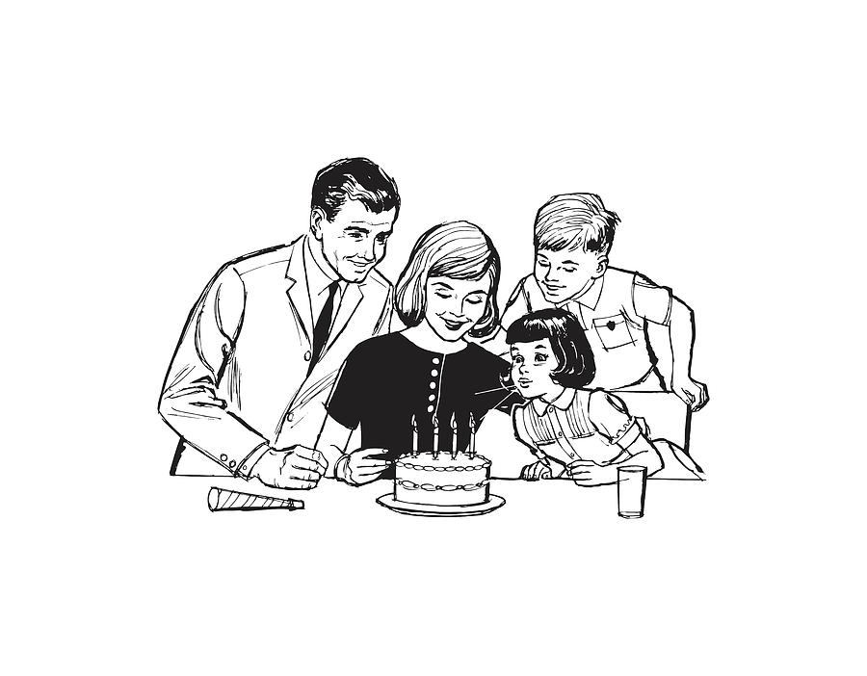

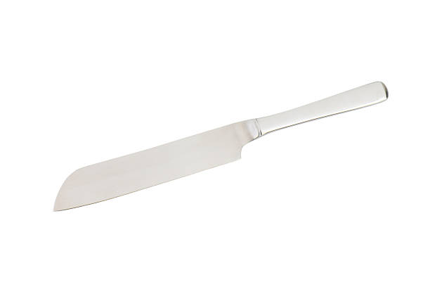
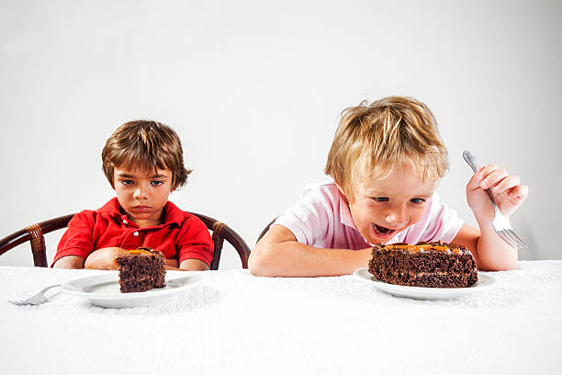
Adversarial Search - Games
Classic Game Theory Game: Cake Splitting
One child is the “cutter”
The other child is the “chooser”

Slide 12
Adversarial Search - Games
Ignore for a moment the questionable parenting choices involved here…
Giving a young child a knife?!?
Giving an entire cake split between two kids!?!
Let’s say that you are the “cutter”
What should you do to maximize the amount of cake you get?

Slide 13
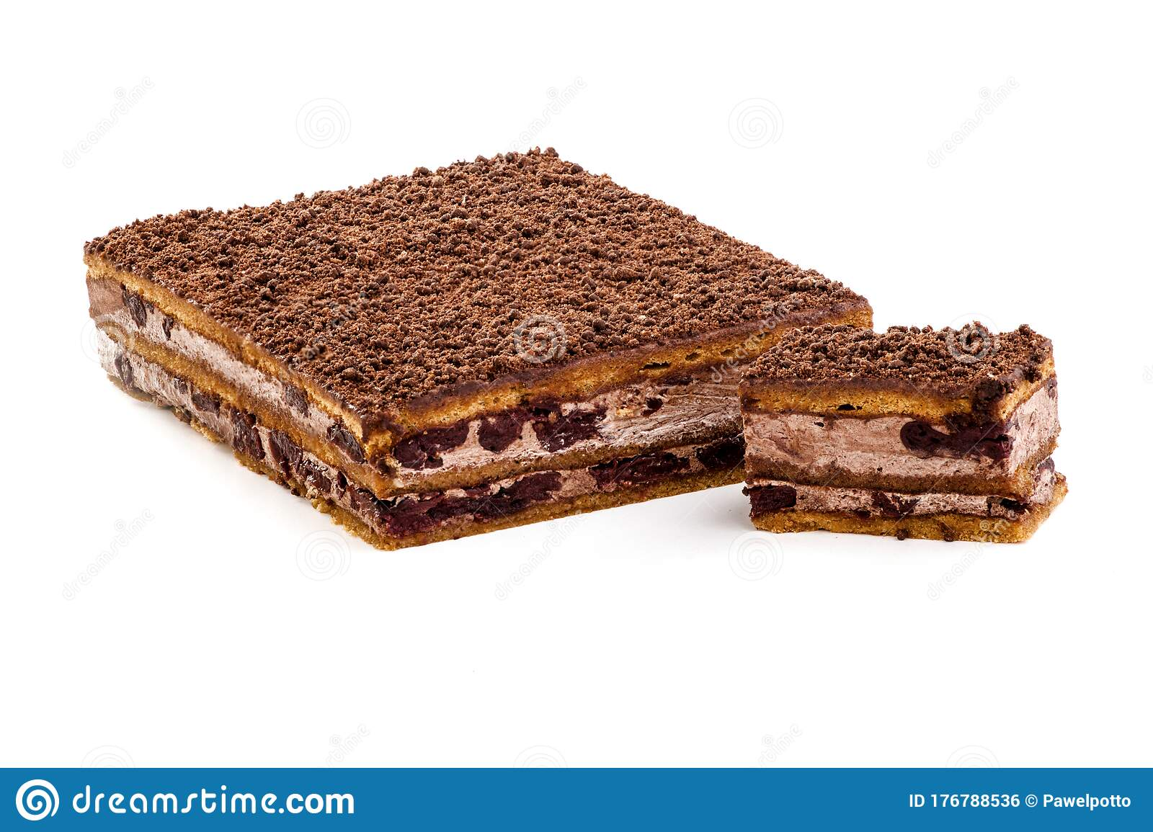
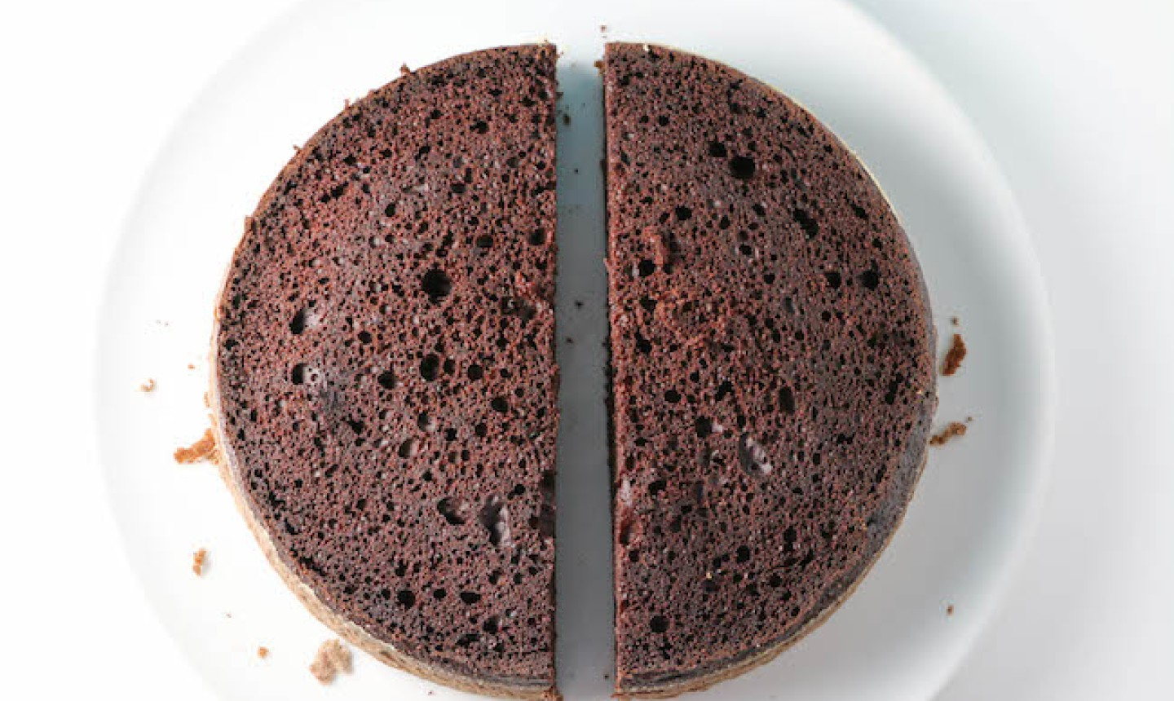
Adversarial Search - Games
If you cut the pieces unevenly…
There will be a big piece and a small piece…
Your sibling, being rational, will always pick the big piece…
Leaving you with the small piece…
☹
If instead, you cut the pieces as evenly as possible…
There will be two pieces of essentially equal size
Your sibling will take one of these
Leaving you with a piece of equal size.
This is the best you can hope for in this situation – your sibling will never allow you to pick a piece BIGGER than them. So the best you can do is “about even”

Slide 14
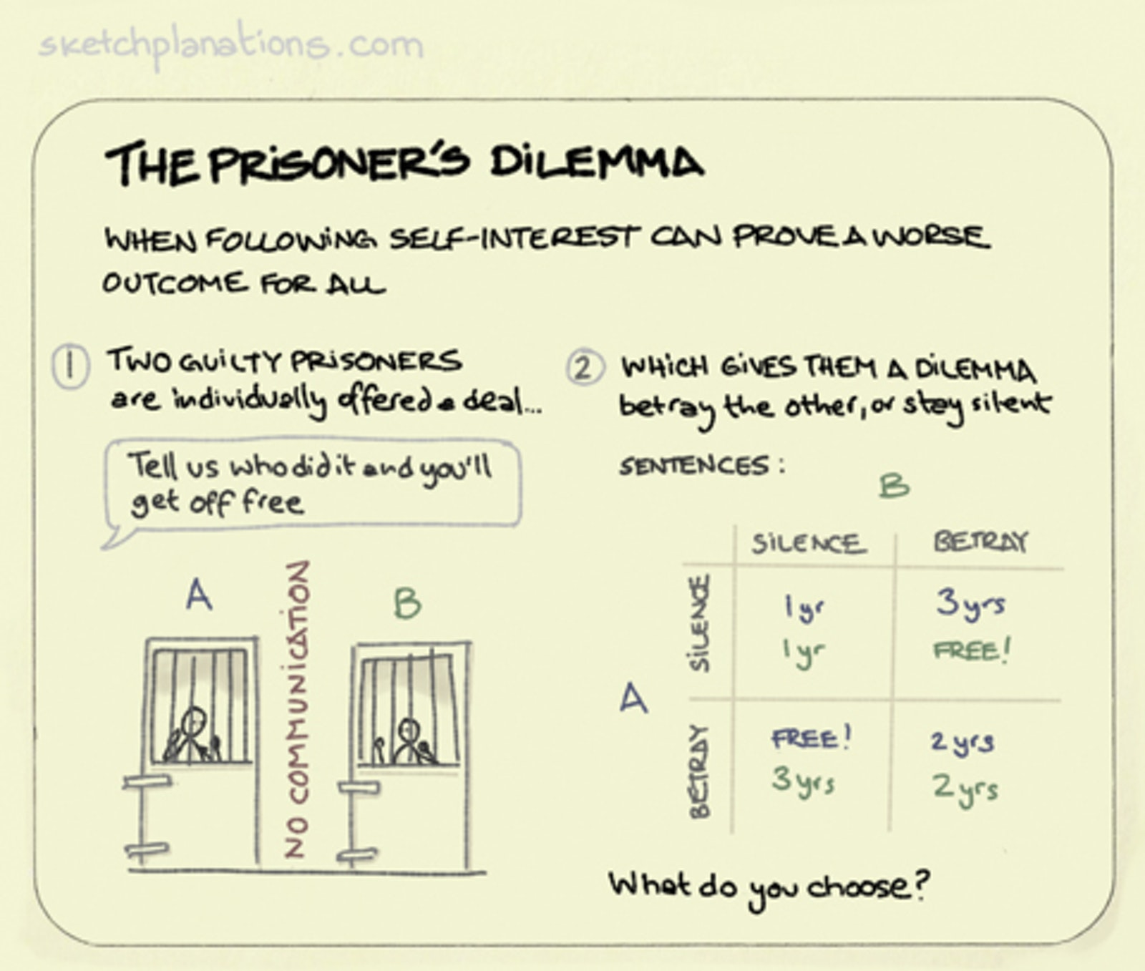
Adversarial Search - Games
Another classic game theory game is the “Prisoner’s Dilemma”

Slide 15
Adversarial Search - Games
The properties of a game theory game:
The game has two players.
The game is a turn-taking game.
The players are perfectly rational.
The players want to maximize their own score.
Moves are deterministic.
Game has a zero-sum (good for one is bad for the other).
Perfect information available to both players.
Notes:
For those of you who have taken fundamentals of game dev, you know that game theory even though that term might make you think of a large heady idea, e.g., “the theory of game design” or the “the theory of game development” in truth, game theory is a notion that is born out of economics, and captures a very, very specific “kind” of game.
The game has exactly two players – I’m sure all of you can think of tons of games that have either more or fewer numbers of players, but those wouldn’t be considered Game Theory games.
The game is a turn-taking game: I make a move then you make a move (and sometimes that’s it, a la the ‘cake splitting’ example). Or sometimes it becomes my move again, then yours etc.
perfectly rational: we’ve already discussed this, but it means that the players are out to win. There’s no sense of mercy here. Maybe when playing with a child or a loved one you might “take it easy” or “let them win” – that notion has no place here. In other words: you’ll always make the best move possible.
In other words: you are trying to maximize your own score (where this can be both a measure of your performance *during* the game as well as the degree to which you won (e.g., an absolute win is better than a tie or stalemate, which is better than a loss).
Moves are deterministic: when you make a move you know exactly what the outcome is going to be. As opposed to non-deterministic or uncertain.
Game has a zero-sum: this is an important takeaway that we’ll be chatting about several times. But we can say that what is good for one is bad for the other, and vice versa. Or in other words: making a move that *hurts you* is the moral equivalent of making a move that *helps me*
And they are games of perfect information. Everyone can see everything.

Slide 16
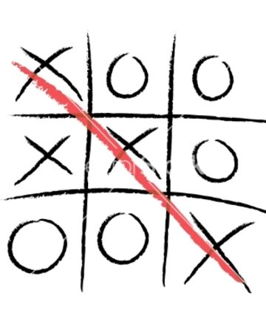
Adversarial Search - Games
A more “traditional” game that has these properties is Tic-Tac-Toe
Two players
Turn taking
Deterministic
Perfect information
In theory, both players are trying to win and make the best move possible.
Notes:
A helpful way for you to be thinking about search is to think of moving from state to state as a tree of game states. We can do this with a nice example of a game theory game: Tic-Tac-Toe. It has two players, it’s turn-taking, moves are deterministic, it’s perfect information, and in theory the people playing it are trying to win and will always make the best move possible.
We can imagine what this looks like: if we start with an empty board and say that X goes first, then there’s 9 possible “first” states that we can visit from here: X can place their mark in any of the 9 available squares.
From EACH of those states, there are 8 possible next states, i.e., one state for each place where O might make their next move. So we can see that it blows up pretty quickly!

Slide 17
Adversarial Search - Games
And just as we’ve constructed state trees for navigation…
We can construct a tree for all of the different game states you can reach in Tic-Tac-Toe as well! Helpful for search!
9 possible child states
X
X
X
Each of these has 8 possible child states
X
X
X
X
X
X
X
O
X
O
X
Each of these has 7 possible child states
O
etc.
Notes:
A helpful way for you to be thinking about search is to think of moving from state to state as a tree of game states. We can do this with a nice example of a game theory game: Tic-Tac-Toe. It has two players, it’s turn-taking, moves are deterministic, it’s perfect information, and in theory the people playing it are trying to win and will always make the best move possible.
We can imagine what this looks like: if we start with an empty board and say that X goes first, then there’s 9 possible “first” states that we can visit from here: X can place their mark in any of the 9 available squares.
From EACH of those states, there are 8 possible next states, i.e., one state for each place where O might make their next move. So we can see that it blows up pretty quickly!

Slide 18
Adversarial Search - Games
Jumping further into the game…
Current Game State (X to move)
X
O
X
O
X
O
Non-Terminal States
X
O
X
X
O
X
X
O
X
Terminal State
O
X
O
X
O
X
O
X
X
O
X
O
This state is very good for X, and very bad for O!
Notes:
Let’s jump further ahead into the game, and say that this is the current board state, and it’s X’s turn.
There are three possible next states from here – the three places where X can move next. We can see here that one of them is very good for X – they win! And because it is zero-sum: what is good for X is bad for O!
So that state would be called a terminal state, since it ends the game, and specifically it’s a terminal state that X wants to reach, and that O would have preferred to have avoided at all costs.
All of these other nodes are non-terminal states. We don’t have three in a row yet, so the game continues.

Slide 19
Utility
A utility function defines a numeric value for each terminal state for a player.
Sometimes called payoff function or objective function.
In Tic-Tac-Toe, the function is easy:
For any terminal state where you win: +1
For any terminal state where you lose: -1
For any terminal state that is a draw: 0
X
O
X
O
X
O
Utility for O: +1
Utility for X: -1
Notes:
Some more vocabulary: a utility function looks at those terminal states, and assigns a numeriv calue for each terminal state for a player. Also sometimes called the payoff function or objective function
In Tic-Tac-Toe, the function is easy – if it’s a terminal state where you win, +1, if you lose, -1, and a draw, 0.
And again, this if “for a player” – so the same state might mean different things to different players. Take this – this state’s utility for O is +1, because O wins, but the utility for X is -1, because, ah, O wins.

Slide 20
Utility
Although it might make sense to think of each agent having their own utility function…
e.g., X has a function that gives X victories a score of +1
and O has a function that gives O victories a score of +1
In these two-payer zero-sum games, we can just get away with using a single function for both agents.
e.g., the game has a function that gives O victories a score of +1
And that same function gives X victories a score of -1
Thus the twist: *not every agent wants a “high score” here*
With this conception: X is happiest when the utility score is low!
And O, clearly, is happiest when the utility score is high.
Notes:
So, here is the thing that when I was first learning it, I had to kind of twist my thinking around a bit to accept this. You don’t actually *need* two different utility functions for the two different agents. Even though it maybe *feels better* to be like, “oh, yes, O has their own utility function and X has their own utility function, that will give the same state a different score…
Because it’s a zero-sum game. because what’s good for one is bad for another, you can get away with having just a SINGLE utility function. Kind of from one agent’s perspective.

Slide 21
Utility
So instead of keeping track of “O” utility and “X” utility separately…
We just give each terminal state a single utility score.
So again: high scores are good for O, low scores good for X
X
O
X
O
X
O
O
X
O
X
O
O
X
O
X
O
O
X
O
X
O
O
X
X
X
O
X
X
O
X
X
X
O
Utility score: +1
Utility score: -1
Utility score: -1
Utility score: +1
Utility score: +0
O
O
O
O
O
O
X
X
O
X
X
X
O
O
O
O
X
X
X
X
O
X
X
X
X
X
O
Utility score: +1
Utility score: +1
Utility score: -1
Utility score: +0
Notes:
So, here is the thing that when I was first learning it, I had to kind of twist my thinking around a bit to accept this. You don’t actually *need* two different utility functions for the two different agents. Even though it maybe *feels better* to be like, “oh, yes, O has their own utility function and X has their own utility function, that will give the same state a different score…
Because it’s a zero-sum game. because what’s good for one is bad for another, you can get away with having just a SINGLE utility function. Kind of from one agent’s perspective.

Slide 22
Utility
You might say that X wants to minimize the utility score…
And that O wants to maximize the utility score..
To distance ourselves from any specific game, instead of calling the players X and O…
We’ll call the player who wants to maximize the score “Max”
We’ll call the player who wants to minimize the score “Min”
Notes:
With the previous set-up, you might say that X wants to minimize the utility score
And that O wants to maximize the utility score.
Because we want this algorithm to be game agnostic (i.e., we want it to work for Tic-Tac-Toe, and other game theory game), let’s rename the two players to be Max and Min. Max is the agent that wants to maximize the utility score, and Min will be the agent that wants to minimize the utility score.

Slide 23
Minimizing and Maximizing Utility
Let’s see this notion of a “Min” player and a “Max” player in action!
Let’s invent a great, fun new game, called ”COLUMN” and “ROW”
To play this game, we need a table, with some number of columns and rows.
This table below has two columns and four rows.
And each cell of the table has a number in it.
col 0
col 1
row0
5 | 6
-9 | 8
-20 | 9
1000000 | 12
row 1
row 2
row 4
Notes:
To illustrate this notion of getting away with a single utility score, with one agent wanting to maximize a score, and the other player wanting to minimize a score, let’s introduce this super fun game that’s sure to be the talk of the town: column and row.
The rules are simple. Imagine a table filled with arbitrary numbers. Here’s one such table, but you could pick a table with any number of rows and columns and whatever numbers inside.
On Max’s turn, Max picks a column. Then on Min’s turn, they pick a row. With a column and row selected, we can then identify a specific cell in the table. And whatever number is there is what score Max will get. Max wants to get a super high score, and Min would prefer for Max to get a super low score.
So, given these rules and this specific table, what column should Max pick?

Slide 24
Minimizing and Maximizing Utility
Max
5 | 6
-9 | 8
-20 | 9
1000000 | 12
Here’s how to play:
Player 1 (“Max”) picks a column.
Player 2 (“Min”) picks a row.
The utility score/objective function/Max’s points are whatever is in the corresponding cell of the table specified by the column and row.
Max wants as many points as possible, Min wants as few points as possible.
Given the above table, what column should Max pick?
Min
Notes:
To illustrate this notion of getting away with a single utility score, with one agent wanting to maximize a score, and the other player wanting to minimize a score, let’s introduce this super fun game that’s sure to be the talk of the town: column and row.
The rules are simple. Imagine a table filled with arbitrary numbers. Here’s one such table, but you could pick a table with any number of rows and columns and whatever numbers inside.
On Max’s turn, Max picks a column. Then on Min’s turn, they pick a row. With a column and row selected, we can then identify a specific cell in the table. And whatever number is there is what score Max will get. Max wants to get a super high score, and Min would prefer for Max to get a super low score.
So, given these rules and this specific table, what column should Max pick?

Slide 25
Minimizing and Maximizing Utility
5 | 6
-9 | 8
-20 | 9
1000000 | 12
The left column looks awfully juicy…
Max could get a million points!
Or can he?
Given the stipulations we already discussed (all players are playing rationally, what is good for one player is bad for another, etc.) what will happen if Max picks the left column?
Min will choose the 3rd row! Max will get a measly -20 points!

Slide 26
Minimizing and Maximizing Utility
OK – what would happen if Max chose the right-hand column?
It’s not as exciting, but choosing the right column would get Max a score of 6.
Because Min will still pick the row that minimizes Max’s score.
And though 6 is way less than a million, it’s a much better result than getting -20.
And so truly, this particular game only boils down to Max really being able to choose between 6 and -20. Given that, the choice is clear!
5 | 6
-9 | 8
-20 | 9
1000000 | 12
Notes:
So, if we look at the other choice for Max – what would have happened if they had picked the other column?
They would have gotten a score of 6.
This is one reason why these constrained games are nice… there is frequently a “correct” answer as to what you are supposed to do! Especially for super simple games like this.

Slide 27
Game Trees
One issue with COLUMN and ROW is that both players only make one move, and the number of choices is so limited.
But in many games (e.g., tic-tac-toe, chess), there is back and forth.
Terminal states come after many turns.
For these games:
A Turn refers to both players making a move
(e.g., X and O both go, or White and Black both go, or Max and Min both go).
A Ply refers to one player making a move (e.g., just X/White/Max goes)
You can think of a ply as a “half turn”
Notes:
I’m going to do my best to stick to this vocabulary of turn and ply – but I do have a bad habit of using “turn” and “move” interchangeably. Which works is casual parlance, but can potentially lead to confusion here. So if I say the wrong thing and it doesn’t make sense or you are confused, definitely stop me right away!

Slide 28
Game Trees – Common Representation
“Max Node”
Max’s turn to move
A
“Min Node”
Min’s turn to move
B
C
D
Terminal Nodes (with Utility values)
Notes:
So, to help us understand searching in an adversarial search space, we’re going to see this representation a lot.
Each triangle here is a node, i.e., a representation of the state.
The orientation and the color of the triangle symbolizes whose move it is – I’m using these blue, “right side up” triangles to represent state’s where Max gets to make a move, and the brown, upside triangles to represent states where Min gets to make a move, and so you can see that it will go back and forth – first Max goes, then Min, then Max, etc.
Eventually, the bottom of the search tree pans out with terminal nodes, with utility values – with high numbers being what Max wants to see, and low numbers being what Min wants to see.

Slide 29
Game Trees – Common Representation
We’re going to spending a lot of time with this “abstract” representation, since we’ll be covering a generic algorithm that applies to many games…
“Max Node”
Max’s turn to move
A
“Min Node”
Min’s turn to move
B
C
D
Terminal Nodes (with Utility values)
Notes:
So, to help us understand searching in an adversarial search space, we’re going to see this representation a lot.
Each triangle here is a node, i.e., a representation of the state.
The orientation and the color of the triangle symbolizes whose move it is – I’m using these blue, “right side up” triangles to represent state’s where Max gets to make a move, and the brown, upside triangles to represent states where Min gets to make a move, and so you can see that it will go back and forth – first Max goes, then Min, then Max, etc.
Eventually, the bottom of the search tree pans out with terminal nodes, with utility values – with high numbers being what Max wants to see, and low numbers being what Min wants to see.

Slide 30
Game Trees – Common Representation
But remember: each of these nodes represents a ‘game state’, and “Max” and “Min” represent players! So you could imagine this tree looking like this for Tic Tac Toe
Let’s say that X is the “Max” player and O is the “Min” player.
“Max Node”
Max’s turn to move
current state,
X’s turn. Three moves they can make
X
O
X
A
“Min Node”
Min’s turn to move
O
X
O
X
O
X
B
X
O
X
C
X
O
X
D
X
O
O
O
X
X
O
X
X
O
X
O
Non terminal state, now it is O’s turn (Min). Two possible moves
Non terminal state, now it is O’s turn (Min). Two possible moves
A terminal state with a utility score of +1
X
O
X
X
O
X
X
O
X
X
O
X
E
G
H
O
O
F
O
O
O
O
X
O
X
X
X
O
X
X
O
X
O
X
O
O
Non terminal state, now it is X’s turn (Max). One possible move
Non terminal state, now it is X’s turn (Max). One possible move.
Non terminal state, now it is X’s turn (Min). One possible move.
Terminal state, with a utility score of -1
will be terminal with score of 0
I
J
will be terminal with score of +1
will be terminal with score of 0
K
Notes:
So, to help us understand searching in an adversarial search space, we’re going to see this representation a lot.
Each triangle here is a node, i.e., a representation of the state.
The orientation and the color of the triangle symbolizes whose move it is – I’m using these blue, “right side up” triangles to represent state’s where Max gets to make a move, and the brown, upside triangles to represent states where Min gets to make a move, and so you can see that it will go back and forth – first Max goes, then Min, then Max, etc.
Eventually, the bottom of the search tree pans out with terminal nodes, with utility values – with high numbers being what Max wants to see, and low numbers being what Min wants to see.

Slide 31
So again, that’s what we’re “representing” with this abstract form. Each triangle is a game state, and the color/direction of the triangle represents whose turn it is.
Let’s shift gears to this game – this is like the
“column and row game”
Max makes a move, Min makes a move, then game is over.
“Max Node”
Max’s turn to move
A
“Min Node”
Min’s turn to move
B
C
D
3
12
8
2
4
6
14
5
2
Notes:
So, let’s say that this is our set up – Max has a choice of three moves, that will take the game into three different states: State B, C, and D.
From each of those states, it will be Min’s move, and we’re just saying that Min has the ability to make three different moves, taking us into three different terminal states.
so, the big question for Max: which state is best? B, C, or D? Keeping in mind that once Max makes that choice, the power goes into Min’s hands, and Min is going to make the choice that, well, Minmize’s Max’s score.

Slide 32
“Max Node”
Max’s turn to move
*Currently in State A
*Max needs to decide which next state is best: B, C, or D
*To do that, can think about what Min will do each of those states.
A
“Min Node”
Min’s turn to move
B
C
D
3
12
8
2
4
6
14
5
2
Notes:
So, let’s say that this is our set up – Max has a choice of three moves, that will take the game into three different states: State B, C, and D.
From each of those states, it will be Min’s move, and we’re just saying that Min has the ability to make three different moves, taking us into three different terminal states.
so, the big question for Max: which state is best? B, C, or D? Keeping in mind that once Max makes that choice, the power goes into Min’s hands, and Min is going to make the choice that, well, Minmize’s Max’s score.

Slide 33
3 | 2 | 14
12 | 4 | 5
8 | 6 | 2
“Max Node”
Max’s turn to move
If you’d like to think of this as “column and row”, the above table captures the below utility values, right?
A
“Min Node”
Min’s turn to move
B
C
D
3
12
8
2
4
6
14
5
2
Notes:
So, let’s say that this is our set up – Max has a choice of three moves, that will take the game into three different states: State B, C, and D.
From each of those states, it will be Min’s move, and we’re just saying that Min has the ability to make three different moves, taking us into three different terminal states.
so, the big question for Max: which state is best? B, C, or D? Keeping in mind that once Max makes that choice, the power goes into Min’s hands, and Min is going to make the choice that, well, Minmize’s Max’s score.

Slide 34
3 | 2 | 14
12 | 4 | 5
8 | 6 | 2
“Max Node”
Max’s turn to move
If Max makes this choice, then he allows Min to choose between 3, 12, and 8
A
“Min Node”
Min’s turn to move
B
C
D
3
12
8
2
4
6
14
5
2
Notes:
So, let’s say that this is our set up – Max has a choice of three moves, that will take the game into three different states: State B, C, and D.
From each of those states, it will be Min’s move, and we’re just saying that Min has the ability to make three different moves, taking us into three different terminal states.
so, the big question for Max: which state is best? B, C, or D? Keeping in mind that once Max makes that choice, the power goes into Min’s hands, and Min is going to make the choice that, well, Minmize’s Max’s score.

Slide 35
3 | 2 | 14
12 | 4 | 5
8 | 6 | 2
“Max Node”
Max’s turn to move
And if Max had made this choice instead, then Min gets to decide between 2, 4, and 6
A
“Min Node”
Min’s turn to move
B
C
D
3
12
8
2
4
6
14
5
2
Notes:
So, let’s say that this is our set up – Max has a choice of three moves, that will take the game into three different states: State B, C, and D.
From each of those states, it will be Min’s move, and we’re just saying that Min has the ability to make three different moves, taking us into three different terminal states.
so, the big question for Max: which state is best? B, C, or D? Keeping in mind that once Max makes that choice, the power goes into Min’s hands, and Min is going to make the choice that, well, Minmize’s Max’s score.

Slide 36
*What if Max makes a move to take us to state B?
*Now Min needs to make a move. Has three choices – one that has a utility of 3, one that’s 12, and one that’s 8.
*Min is happiest when the utility score is low. So if max gets us to state B, Min will pick the state with the utility of 3.
“Max Node”
Max’s turn to move
A
“Min Node”
Min’s turn to move
B
C
D
3
3
12
8
2
4
6
14
5
2
Notes:
Let’s just imagine for a minute that Max made whatever choice that took us from state A to state B. We can imagine/foresee what would happen.
It’s Min’s move. They have three choices – one that takes us to a state that has a utility of 3, one that takes us to a different state that is a utility of 12, and a third choice that takes us to 8.
We recall: Min is happiest when the utility score is low. So if we find ourselves in state B, we know that Min is going to make the move that will have a utility score of 3. And we can annotate state B with that number – Max can keep in mind: OK: if I make this move, I’m going to end up with a score of 3.

Slide 37
*Let’s leave B marked as a reminder. Max says “if I choose state B, then I know I will end the game with a score of 3”
*But let’s imagine instead that Max had taken us to state C?
*Again, Min needs to make a choice.
*Here, Min picks 2, since it’s the tiniest option.
“Max Node”
Max’s turn to move
A
“Min Node”
Min’s turn to move
B
C
D
3
2
3
12
8
2
4
6
14
5
2
Notes:
We can conduct the same thought experiment going down the other path. What if instead Max had made the move to go to state C.
Again, after we do that, Min gets to make their choice.
They will weight all of their options, as always, pick the option that yields the smallest utility.
So we can mark that too for state C. Max knows that if he picks C, his score will end up being 2.

Slide 38
*Let’s keep track of that, too. Max now knows, “If I choose state C, then I will end the game with a score of 2”
*What if Max had picked D?
*Don’t be fooled by that enticing 14! It’s Min’s turn to make the move.
*And again, Min likes small options. It picks the 2.
“Max Node”
Max’s turn to move
A
“Min Node”
Min’s turn to move
B
C
D
3
2
2
3
12
8
2
4
6
14
5
2
Notes:
And we do the same thing with state D. What do you think we’ll mark this as?
Don’t be fooled by that 14! Remember: Min gets to move, and Min likes small numbers. So Min will pick the 2.

Slide 39
*So, Max knows if he picks state B, Min will see to it that his score is 3.
*And that is Max picks state C, the score will be 2
*And state D would also yield 2.
*So the choice is clear! Pick State B!
*Because that “forces” Min to pick 3
*Which is maximum points Max can hope for here
“Max Node”
Max’s turn to move
A
“Min Node”
Min’s turn to move
3
B
C
D
3
2
2
3
12
8
2
4
6
14
5
2
Notes:
We are currently in state

Slide 40
Minimax Search
So, let’s verbalize that algorithm:
We expanded the game tree (say using depth first search).
Any given level/layer is either a set of:
Max Nodes
Min Nodes
Leaf nodes / Terminal Nodes
Leaf nodes / terminal nodes have a value equal to their utility.
Note: leaf node doesn’t *necessarily* mean “game end” state.
It means “bottom of the tree” – you might stop expanding early for large search spaces!
Value of a node on a min layer is the lowest value of any of its children.
Value of a node on a max layer is the highest value of any of its children.
Notes:
So I’m hoping by this point, we’re beginning to develop an intuitive sense as to how this algorithm works, what we’re looking for.
We’ll see what we mean about leaf nodes possibly being different from terminal node: terminal node means that it ends the game. Leaf node means that (for now) we haven’t expanded their children states (though they may have them).
And just as we saw before, on the non-terminal states, we can give those nodes values too – what that value “is” / how it is determined changes slightly based on if it is a min layer node or a max layer node.

Slide 41
“Max Node”
Max’s turn to move
Max Layer -- Value of each node is that of largest child
A
“Min Node”
Min’s turn to move
3
B
C
D
3
2
2
Min Layer -- Value of each node is that of the smallest child
3
12
8
2
4
6
14
5
2
Terminal / Leaf Nodes – Values are Utility Scores
Notes:
So, revisiting this, we still have our terminal nodes (or, possibly, leaf nodes) where the values are the utility scores.
Each node on a min layer gets a value whose number is the smallest of all of its children (so B is 3, C is 2, D is 2)
and each node on a max layer will have a value that is equal to its largest child (here, 3).

Slide 42
Minimax Search Algorithm
The following set of slides will look at some pseudo-code…
It isn’t a total ton of lines!
It’s going to involve some recursion…
And will involve three different functions:
min_max()
find_max()
find_min()

Slide 43
Minimax Search Algorithm
This is the “starting” point!
You can imagine that the Node ‘n’ you pass into this is the ‘current’ state, and you are trying to figure out what move to make to lead you to victory.
function min_max(Node n){
best = find_max(n)
return the move/action that results in best (highest) utility
//This is assuming that opponent wants to minimize utility.
}

Slide 44
Minimax Search Algorithm – min_max()
function min_max(Node n){
best = find_max(n)
return the move/action that results in best (highest) utility
//This is assuming that opponent wants to minimize utility.
}
You can imagine we are in state A right now.
So we’ve invoked min_max(n), passing in A for n.
We are trying to figure out which next state is best (B, C, or D).
So when we do find_max(n), we’ll soon see it is asking “which child state has the highest value”
A
B
C
D

Slide 45
Minimax Search Algorithm – find_max()
function find_max(Node n){
if n is a leaf node, return the utility of n;
best = -∞
for every child node of n “child” {
child_value = find_min(child);
best = max(best, child_value);
}
return best;
}
Notes:
If n is a leaf node, return its utility – we can’t go further down!
Otherwise – there are additional children that we need to consider.
Initialize a “best” value to a very tiny number (e.g., - infinity).
Then, for every child of our current node, n,
find the “min” of each child – compare that to our current best value, and if that min value is better, then keep track of that.
After looking at every child, return the “best” value.

Slide 46
Minimax Search Algorithm – find_max()
function find_max(Node n){
if n is a leaf node, return the utility of n;
best = -∞
for every child node of n “child” {
child_value = find_min(child);
best = max(best, child_value);
}
return best;
}
A
‘n’
B
C
D
You recall, we previously invoked find_max() with A,
hence, ‘n’ here is a reference to A.
A is not a leaf node, so we don’t break out of the loop.

Slide 47
Minimax Search Algorithm – find_max()
function find_max(Node n){
if n is a leaf node, return the utility of n;
best = -∞
for every child node of n “child” {
child_value = find_min(child);
best = max(best, child_value);
}
return best;
}
A
best = -∞
‘n’
B
C
D
We don’t know what best will be, we initialize it to a very low number. The lowest possible!

Slide 48
Minimax Search Algorithm – find_max()
function find_max(Node n){
if n is a leaf node, return the utility of n;
best = -∞
for every child node of n “child” {
child_value = find_min(child);
best = max(best, child_value);
}
return best;
}
A
best = -∞
‘n’
child
B
C
D
We then loop through each child of n. So, here we’ll start with B. But we’re in a loop, so we’ll also go through C and D eventually.

Slide 49
Minimax Search Algorithm – find_max()
function find_max(Node n){
if n is a leaf node, return the utility of n;
best = -∞
for every child node of n “child” {
child_value = find_min(child);
best = max(best, child_value);
}
return best;
}
A
best = -∞
‘n’
We’re now trying to find out what the value of B is. But, in order to know that, we need to invoke find_min by passing in B.
(We recall that B is a “min node” – it’s value will be the smallest value of all of its children. So we need to check kids!)
B
C
D
child
child_value = ?

Slide 50
Minimax Search Algorithm – find_min()
function find_min(Node n){
if n is a leaf node, return the utility of n;
best = +∞
for every child node of n “child” {
child_value = find_max(child);
best = min(best, child_value);
}
return best;
}
Mostly the same, a few differences!
Notes:
Be aware! We are in a new function now! find_min() – but note how it is, in many ways, very similar to find max!

Slide 51
Minimax Search Algorithm – find_min()
function find_min(Node n){
if n is a leaf node, return the utility of n;
best = +∞
for every child node of n “child” {
child_value = find_max(child);
best = min(best, child_value);
}
return best;
}
//New function name, of course.
//We don’t know how “small” we can get, so initialize to biggest possible number.
//find_max instead of find_min
// Take the minium value of all children.
Notes:
here, our perception of “best” has been inverted, yes? Now, the best is the minimum value we can get. But when looking at all of our children, we need to invoke find_max, because it will be the other guy’s turn on that layer, and we know that *they* will make the move that maximizes their score!

Slide 52
Minimax Search Algorithm – find_min()
function find_min(Node n){
if n is a leaf node, return the utility of n;
best = +∞
for every child node of n “child” {
child_value = find_max(child);
best = min(best, child_value);
}
return best;
}
B
‘n’
So, carrying on from our previous example, we recall we invoked this method passing in ‘B’
3
12
8

Slide 53
Minimax Search Algorithm – find_min()
function find_min(Node n){
if n is a leaf node, return the utility of n;
best = +∞
for every child node of n “child” {
child_value = find_max(child);
best = min(best, child_value);
}
return best;
}
B
‘n’
B is not a leaf node, so we don’t return anything yet.
3
12
8

Slide 54
Minimax Search Algorithm – find_min()
function find_min(Node n){
if n is a leaf node, return the utility of n;
best = +∞
for every child node of n “child” {
child_value = find_max(child);
best = min(best, child_value);
}
return best;
}
B
‘n’
best = +∞
We temporarily set best to be a very high number, with the understanding that it will eventually be replaced with a value from one of its children.
3
12
8

Slide 55
Minimax Search Algorithm – find_min()
function find_min(Node n){
if n is a leaf node, return the utility of n;
best = +∞
for every child node of n “child” {
child_value = find_max(child);
best = min(best, child_value);
}
return best;
}
B
‘n’
best = +∞
child
We plan to visit each child of B, we’ll start with the far left.
3
12
8

Slide 56
Minimax Search Algorithm – find_min()
function find_min(Node n){
if n is a leaf node, return the utility of n;
best = +∞
for every child node of n “child” {
child_value = find_max(child);
best = min(best, child_value);
}
return best;
}
B
‘n’
best = +∞
Now we need to figure out what the value of this child is.
In “real life” we might be looking many turns/plys ahead.
So we generically say, “find the max” of this node (since this layer is a “max’s move” layer.
child
3
12
8
Child_value = ?

Slide 57
Minimax Search Algorithm – find_max()
function find_max(Node n){ // WE ARE BACK IN find_max()!!
if n is a leaf node, return the utility of n;
best = -∞
for every child node of n “child” {
child_value = find_min(child);
best = max(best, child_value);
}
return best;
}
‘n’
3
So we’re BACK to find_max, where ‘n’ is now a reference to that first child we looked at before.

Slide 58
Minimax Search Algorithm – find_max()
function find_max(Node n){
if n is a leaf node, return the utility of n;
best = -∞
for every child node of n “child” {
child_value = find_min(child);
best = max(best, child_value);
}
return best;
}
3
This time, the node we are looking at IS a leaf node, so we return its utility! Which in this case is 3.

Slide 59
Minimax Search Algorithm – find_min()
function find_min(Node n){ // pop up the stack, back to find min!
if n is a leaf node, return the utility of n;
best = +∞
for every child node of n “child” {
child_value = find_max(child);
best = min(best, child_value);
}
return best;
}
B
best = +∞
So, we’re back here! We know that the child value is 3!
child
3
12
8
child_value = 3

Slide 60
Minimax Search Algorithm – find_min()
function find_min(Node n){
if n is a leaf node, return the utility of n;
best = +∞
for every child node of n “child” {
child_value = find_max(child);
best = min(best, child_value);
}
return best;
}
best = +∞
B
best = 3
And here we update the value of best! We compare the current value against the child_value we just found. 3 is MUCH less than positive infinity, so we found a new replacement!
child
3
12
8
child_value = 3

Slide 61
Minimax Search Algorithm – find_min()
function find_min(Node n){
if n is a leaf node, return the utility of n;
best = +∞
for every child node of n “child” {
child_value = find_max(child);
best = min(best, child_value);
}
return best;
}
B
best = 3
The loop then progresses to the next child, where we check in what its value is. We’d call find_max on this new child to discover what it’s utility is.
I’m accelerating things a little here, but we can see that the child value is going to be 12.
child
3
12
8
child_value = ?

Slide 62
Minimax Search Algorithm – find_min()
function find_min(Node n){
if n is a leaf node, return the utility of n;
best = +∞
for every child node of n “child” {
child_value = find_max(child);
best = min(best, child_value);
}
return best;
}
B
best = 3
So we are now asking, what is better, 3 or 12? And from Min’s perspective, 3 is way better, so it doesn’t update.
child
3
12
8
child_value = 12

Slide 63
Minimax Search Algorithm – find_min()
function find_min(Node n){
if n is a leaf node, return the utility of n;
best = +∞
for every child node of n “child” {
child_value = find_max(child);
best = min(best, child_value);
}
return best;
}
B
best = 3
And again, speeding things along here, but hopefully we can see that it will continue to not update here with this third state…
child
3
12
8
child_value = 8

Slide 64
Minimax Complete Example.
Numbers inside the triangles represent “best”
-∞
Notes:
we begin! It’s max’s turn! It wants to make a choice that gives it a high score, but we don’t know what it is yet!

Slide 65
Minimax Complete Example.
-∞
+∞
Notes:
We look at one possible move that takes us to one possible state! But it’s not a leaf node – so it’s Min’s turn to make a move! Min needs to look at its children states, and will pick whichever is best from its perspective, i.e., a low score.

Slide 66
Minimax Complete Example.
-∞
+∞
3
Notes:
It looks at it’s first child, and it IS a leaf node!

Slide 67
Minimax Complete Example.
-∞
3
3
Notes:
It decides that 3 is a much lower score than positive infinity! So it updates what it’s notion of “best” is.

Slide 68
Minimax Complete Example.
-∞
3
3
12
Notes:
It looks at it’s second child.

Slide 69
Minimax Complete Example.
-∞
3
This slide intentionally left “unchanged”!
(i.e., we are highlighting that the algorithm CHECKED if 12 was “better” than 3, but decided that it wasn’t)
3
12
Notes:
The algorithm checks to see if 12 is better than 3. From min’s perspective it isn’t, so 3 remains unchanged as its annotation for being “best”

Slide 70
Minimax Complete Example.
-∞
3
3
12
8
Notes:
And we check another child..

Slide 71
Minimax Complete Example.
-∞
3
And again… compares 3 to 8, but decides that it is happier with 3.
3
12
8
Notes:
And again, determines that it’s current notion of best is still the best.

Slide 72
Minimax Complete Example.
The current best here is now 3 (way better than the negative infinity of a moment ago.)
3
3
3
12
8
Notes:
We then pop a couple of method calls off the call stack, and return to that first call of find_max – we’ve discovered that if we make that move, it will get Max a score of 3, so we jot that down, but we continue the search, because who knows, maybe we can beat it!

Slide 73
Minimax Complete Example.
3
3
+∞
3
12
8
Notes:
We look at our first child, which again is Min’s turn. We initialize it’s “best” to positive infinity, but we’ll need to look at its children to know what it’s actual score is.

Slide 74
Minimax Complete Example.
3
3
+∞
3
12
8
2
Notes:
Min begins the process of looking at its first child, which let’s say is 2.

Slide 75
Minimax Complete Example.
3
3
2
3
12
8
2
Notes:
We update our note to say 2…

Slide 76
Minimax Complete Example.
Pause for dramatic effect here…
Are there any interesting observations that come to mind at this exact moment…?
3
3
2
3
12
8
2
Notes:
That second brown triangle will NEVER be any number greater than 2! Based on the other children it might end up being less, but it certainly won’t be more…
And because of that… we *know* that brown triangle with a 2 has no chance of ever getting picked by Max! Because that top node is always gonna try and pick the “highest number”, and it’s already 3, a number HIGHER than 2. So you and I can use our smart human brains and recognize “hmm! If Max is *never* going to choose this state, why even bother continuing to look at these children…”

Slide 77
Minimax Complete Example.
3
3
2
3
12
8
2
4
Notes:
BUT! The algorithm we’re discussing doesn’t have a smart human brain yet! So it will just valiantly, if foolheartedly, continue on its merry way, looking at the next child, which is 4, which is definitely not better than 2 from Min’s perspective.

Slide 78
Minimax Complete Example.
3
3
2
3
12
8
2
4
-6
Notes:
And then it looks at the next child, and we see, oh hey, it’s -6.

Slide 79
Minimax Complete Example.
3
3
-6
Min gets excited! It found something really low!
3
12
8
2
4
-6
Notes:
Min is like, sweet! I found something super low! If Max ever allows me to get into this state, then I know for sure I’m going to pick the action that takes me to -6.

Slide 80
Minimax Complete Example.
But another “this slide intentionally left unchanged” moment. Max, here, compares it’s current best (3) to the new child value (-6), and decides it would rather stick with 3.
So this top blue triangle *doesn’t* change values.
3
3
-6
3
12
8
2
4
-6
Notes:
But, assuming that everyone is acting rationally, that state will never come to pass, because Max already sees that there’s an option to nets a score of 3. Max is never going to make a move that would produce a utility of -6 when there’s a higher utility for the taking.

Slide 81
Minimax Complete Example.
3
3
-6
+∞
3
12
8
2
4
-6
Notes:
The process continues, we look at the next child

Slide 82
Minimax Complete Example.
3
3
-6
+∞
3
12
8
2
4
-6
14
Notes:
which results in looking at more children.

Slide 83
Minimax Complete Example.
3
3
-6
14
3
12
8
2
4
-6
14
Notes:
We see the utility is 14, and maybe Min is sweating bullets. Min is like, oh no… I really hope I find a child that is less than 14.

Slide 84
Minimax Complete Example.
3
3
-6
14
3
12
8
2
4
-6
14
5
Notes:
And they do find one! the next child is 5

Slide 85
Minimax Complete Example.
3
3
-6
5
3
12
8
2
4
-6
14
5
Notes:
So it updates the score. But Min of course would love for the score to be even lower, so it checks the next child…

Slide 86
Minimax Complete Example.
3
3
-6
5
3
12
8
2
4
-6
14
5
2
Notes:
And finds a score of 2…

Slide 87
Minimax Complete Example.
3
3
-6
2
3
12
8
2
4
-6
14
5
2
Notes:
Which is indeed lower than 5, updating that node’s utility value.

Slide 88
Minimax Complete Example.
But alas for Min, though things just kept getting “better and better” for Min (14, to 5, to 2), because max knows there’s a better option (3) by making a different move, there’s no way that Max will ever want to visit that hypothetical “2” world.
3
3
-6
2
3
12
8
2
4
-6
14
5
2
Notes:
But again, even though from Min’s perspective things were getting better and better, again, because Min would demand that the value be 2 here, and Max has another option where the value can be 3, Max is never going to take the move that would put Min the position to select the “2” option.

Slide 89
Minimax Complete Example.
Remember: each of these branches correspond to a different action that could be taken i.e., a different move that takes us to a different game state.
So in this example, it’s in Max’s best interest to take “Action 1” (whatever that is in this abstract context).
3
Action 1
Action 2
Action 3
3
-6
2
3
12
8
2
4
-6
14
5
2
Notes:
You can think of this as moving a chess piece, or selecting which spot to mark an “X” in tic-tac-toe, or selecting which column in the riveting “ROW and COLUMN” game. Or anything else!

Slide 90
One Potential Pitfall…
So, this seems pretty good!
Max makes moves that force Min to make moves that are best for Max!
With every move that Min makes being a move that forces Max to make a move that’s best for Min!
But what’s a potential problem with how we set this problem up?
Notes:
Hint about the problem: in the examples that we’ve been doing, Max made a move and then Min made a move – what if we are playing a game like Tic Tac Toe or Chess, where there’s much more back and forth? Max goes, then min, then max, then min, etc. etc.?

Slide 91
One Potential Pitfall…
We might not have time to expand the entire tree!
With our COLUMN and ROW game, there were only 8 terminal nodes!
With Tic-Tac-Toe, there are less than 9! Terminal nodes (i.e., 362,880).
With chess, there are over 10⁴⁰ terminal nodes!
That’s a 1 followed by 40 zeroes!
10,000,000,000,000,000,000,000,000,000,000,000,000,000
I believe you pronounce that as “10 duodecillion”
Or you can pronounce it as: too many!
Notes:
That’s 9 factorial.
And chess is of particular interest to all of you because of perhaps obvious reasons ☺ But expanding the tree to the point where you visit all of the nodes is just not feasible!

Slide 92
Alpha-Beta Pruning
To help us handle this, we’ll use something called Alpha-Beta Pruning.
The basic premise: We don’t need to know the utility of every single branch! We only need to know the utility of good moves!
Because we know how Max and Min operate… if we find a path that is worse than one we’ve already found, we know we’re never gonna go down it!

Slide 93
Minimax Complete Example – The Mystery Revealed!
Pause for dramatic effect here…
Are there any interesting observations that come to mind at this exact moment…?
At this moment, we know that going down that “middle branch” will NEVER HAPPEN.
Min has found the value “2” – it might find LOWER numbers as it continues searching, but it will never pick a number higher than 2.
But Max is deciding between 3 and anything else it might find. If the HIGHEST value that the middle branch could possibly yield is 2, then that’s already *not good enough* to tempt Max away from the 3 branch.*
SO WHY EVEN BOTHER checking the rest of it?
3
Action 1
Action 2
3
2
3
12
8
2
Notes:
Do we remember this moment in time?
That second brown triangle will NEVER be any number greater than 2! It might be less, but it certainly won’t be more…
And because of that… we *know* that it has no chance of ever getting picked! Because that top node is always gonna try and pick the “best”, and it’s already 3, a number HIGHER than 2.

Slide 94
Alpha-Beta Pruning
To help us achieve this, we will keep track of two new numbers: alpha and beta.
α
β
alpha
beta
Notes:
It all ties back to this notion of recognizing that there are “bad branches” i.e., branches that we don’t need to bother with, because we know that that the other player is never going to let us take them!
We’ll keep track of two values: alpha and beta.
This is the case we saw on the previous slide.

Slide 95
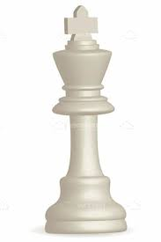
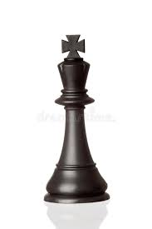
Alpha-Beta Pruning
Alpha will represent “Max’s best outcome”
i.e., the ‘highest utility found so far’
Beta will represent “Min’s best outcome”
i.e., the “lowest utility found so far’
I will accept nothing smaller than alpha!
α
β
I will accept nothing larger than beta!
alpha
max
min
beta
Notes:
It all ties back to this notion of recognizing that there are “bad branches” i.e., branches that we don’t need to bother with, because we know that that the other player is never going to let us take them!
We’ll keep track of two values: alpha and beta.
This is the case we saw on the previous slide.

Slide 96
Alpha-Beta Pruning
Or in other words… when it is Min’s turn to make a move…
Don’t even bother considering any move with a value less than or equal to α. I’ll make sure we never reach that point.
max
min
Notes:
It all ties back to this notion of recognizing that there are “bad branches” i.e., branches that we don’t need to bother with, because we know that that the other player is never going to let us take them!
We’ll keep track of two values: alpha and beta.
This is the case we saw on the previous slide.

Slide 97
Alpha-Beta Pruning
And conversely…. when it is Min’s turn to move…
Oh yeah? Well you don’t need to consider any move with a value greater than or equal to β!
max
min
Notes:
It all ties back to this notion of recognizing that there are “bad branches” i.e., branches that we don’t need to bother with, because we know that that the other player is never going to let us take them!
We’ll keep track of two values: alpha and beta.
This is the case we saw on the previous slide.

Slide 98
Alpha-Beta Pruning
This is the phenomenon that we saw at this moment…
We’re mid-algorithm at this moment, but what is Max’s best outcome? What is α?
3
Action 1
Action 2
3
2
3
12
8
2
Notes:
It all ties back to this notion of recognizing that there are “bad branches” i.e., branches that we don’t need to bother with, because we know that that the other player is never going to let us take them!
We’ll keep track of two values: alpha and beta.
This is the case we saw on the previous slide.

Slide 99
Alpha-Beta Pruning
It’s 3, right?
By this moment, Max knows they can get a score of 3, guaranteed.
So there’s no point of investigating any actions that lead to paths that score less than 3…
alpha=3
3
Action 1
Action 2
3
2
3
12
8
2
Notes:
It all ties back to this notion of recognizing that there are “bad branches” i.e., branches that we don’t need to bother with, because we know that that the other player is never going to let us take them!
We’ll keep track of two values: alpha and beta.
This is the case we saw on the previous slide.

Slide 100
Alpha-Beta Pruning
As previously discussed, this branch will never yield a score higher than 2, which is *less* than what Max can get through other actions. Which is this situation, right?
I don’t need to waste any more time thinking through this branch, Max is never going to choose ‘action 2’ at this point.
Don’t even bother considering any move with a value less than or equal to α. I’ll make sure we never reach that point.
3
max
Action 1
Action 2
3
2
3
12
8
2
min
Notes:
It all ties back to this notion of recognizing that there are “bad branches” i.e., branches that we don’t need to bother with, because we know that that the other player is never going to let us take them!
We’ll keep track of two values: alpha and beta.
This is the case we saw on the previous slide.

Slide 101
Alpha-Beta Pruning
And just to show the other side of it, we could see it going the other way too…
Note that we are starting here on a min-layer.
I don’t need to waste any more time thinking through this branch, Min is never going to choose ‘action 2’ at this point.
Well you don’t need to consider any move with a value greater than or equal to β!
8
Beta is 8
min
Action 1
Action 2
8
9
8
-27
1
9
could potentially be *tons* of other children, but not point in exploring them at this point!
max
Notes:
It all ties back to this notion of recognizing that there are “bad branches” i.e., branches that we don’t need to bother with, because we know that that the other player is never going to let us take them!
We’ll keep track of two values: alpha and beta.
This is the case we saw on the previous slide.

Slide 102
Alpha-Beta Pruning
This process is known as pruning
Like with ‘actual’ pruning in a real life garden…
We are cutting off branches on our tree that are unnecessary!
8
Beta is 8
Action 1
Action 2
8
9
8
1
Pruned!
-27
9
could potentially be *tons* of other children, but not point in exploring them at this point!
Notes:
It all ties back to this notion of recognizing that there are “bad branches” i.e., branches that we don’t need to bother with, because we know that that the other player is never going to let us take them!
We’ll keep track of two values: alpha and beta.
This is the case we saw on the previous slide.

Slide 103
Alpha-Beta Pruning – the concept on one slide
To help us achieve this, we will keep track of two numbers, alpha and beta.
α = the highest utility found so far (i.e., Max’s best outcome).
β = the lowest utility found so far (i.e., Min’s best outcome).
When Max makes moves, don’t bother with values >= β
-- Because Min will never allow those to take place.
When Min makes moves, don’t bother with values <= α
-- Because Max will never allow those to take place.
Notes:
It all ties back to this notion of recognizing that there are “bad branches” i.e., branches that we don’t need to bother with, because we know that that the other player is never going to let us take them!
We’ll keep track of two values: alpha and beta.
This is the case we saw on the previous slide.

Slide 104
Minimax Search with Alpha-Beta Pruning
Let’s revisit the Minimax pseudocode, now with alpha-beta pruning. Still involves three (slightly altered) functions:
min_max_ab(node)
find_max_ab(node, α, β)
find_min_ab(node, α, β)
function min_max_ab(Node n){
best = find_max_ab(n, -∞,+∞)
return the move that creates the best utility.
}
The algorithm starts the same way, but now find_max is replaced with find_max_ab, that takes in the current alpha value and beta values (initialized to extremes).

Slide 105
Minimax Search with Alpha-Beta Pruning – find_max_ab()
function find_max_ab(Node n, α, β){
if n is a leaf node, return the utility of n;
best = -∞
for every child node of n “child” {
child_value = find_min_ab(child, α, β);
best = max(best, child_value);
if best >= β, return best;
α = max(α, best);
}
return best;
}

Slide 106
Minimax Search with Alpha-Beta Pruning – find_max_ab()
function find_max_ab(Node n, α, β){
if n is a leaf node, return the utility of n;
best = -∞
for every child node of n “child” {
child_value = find_min_ab(child, α, β);
best = max(best, child_value);
if best >= β, return best;
α = max(α, best);
}
return best;
}
//update the parameter list (and name)
//Pass in alpha and //beta as well as child.
//Check to see if worth pursuing..
Here we are highlighting the differences between this and the non-pruning version!

Slide 107
Minimax Search with Alpha-Beta Pruning – find_min_ab()
function find_min_ab(Node n, α, β){
if n is a leaf node, return the utility of n;
best = +∞
for every child node of n “child” {
child_value = find_max_ab(child, α, β);
best = min(best, child_value);
if best <= α, return best;
β = min(β, best);
}
return best;
}
And once again, find_min is basically the inversion.
Pay careful attention to your >= and your <= signs!

Slide 108
Alpha Beta Pruning Complete Example.
α = -∞
β = +∞
Max wants to figure out what the best move to make is!
Note that in addition to the node itself having the “best” value, we are also passing down the values of alpha and beta.
-∞

Slide 109
Alpha Beta Pruning Complete Example.
α = -∞
β = +∞
Max imagines what life would be like taking an action that leads to a particular state.
In this state, it’s now Min’s turn. We need to imagine the possible moves that Min might make.
-∞
α = -∞
β = +∞
+∞

Slide 110
Alpha Beta Pruning Complete Example.
α = -∞
β = +∞
One action Min might make takes us to a terminal state with a utility value of 3.
-∞
α = -∞
β = +∞
+∞
3

Slide 111
Alpha Beta Pruning Complete Example.
Min had been afraid that the best it could do was + ∞, but 3 is much lower than that! So Min updates its β value.
In other words, if Max made the initial move to get us down this branch, then Min will accept nothing more than 3.
But… maybe it could do even better…
α = -∞
β = +∞
-∞
α = -∞
β = +∞ 3
3
3
Notes:
Answer: it implies Max had already found a better utility than what this branch will give it, so Max would never go down this path, so there’s no point in doing any more calculations here.

Slide 112
Alpha Beta Pruning Complete Example.
α = -∞
β = +∞
Also note, behind the scenes here, it checks to see if the current best, (here, 3) is <= to alpha.
3 is NOT less than or equal to negative infinity.
If best HAD been lower than alpha, there’s no need to check any more of this min node’s children. Why?
-∞
α = -∞
β = +∞ 3
3
3
Answer: Because if it was, it implies that a better action for Max had already been found! So we could prune off the rest of the children here. Again, that’s not the case here.
Notes:
Answer: it implies Max had already found a better utility than what this branch will give it, so Max would never go down this path, so there’s no point in doing any more calculations here.

Slide 113
Alpha Beta Pruning Complete Example.
We visit the next child. It is a terminal node, so we immediately return its utility of 12.
Do we update “best”? Do we update beta? Do we update alpha?
12 is not “better than” 3, from Min’s perspective, so nothing really changes.
“best” for this node is still 3.
β for this node is still 3.
α = -∞
β = +∞
-∞
α = -∞
β = 3
3
3
12

Slide 114
Alpha Beta Pruning Complete Example.
And again, we visit the third child, which is a leaf node, so it returns its value (here, 8).
Inside of “find_min” we compare “best” (currently 3) with the child_value (here 8), and have best be the smaller of the two. So best remains 3.
And we again check to see if best is less than alpha (because if it is, Max will never come down this path in the first place and we can stop visiting children).
(Here, “best” ISN’T less than alpha. Best is still 3, which is the same as beta, so beta remains unchanged).
α = -∞
β = +∞
-∞
α = -∞
β = 3
3
3
12
8

Slide 115
Alpha Beta Pruning Complete Example.
We’re now “back” into find_max, at the top node.
It just discovered the value of it’s first child_value (3).
3 is much better than negative infinity from max’s perspective.
So it updates its best value to be 3, and sets it’s alpha to be 3 – it won’t accept anything less than 3 moving forward.
It then moves on to the next child…
α = -∞ 3
β = +∞
3
α = -∞
β = 3
3
3
12
8

Slide 116
Alpha Beta Pruning Complete Example.
So we imagine what life will be like if Max took a different initial action.
We pass the ‘parent’ values alpha and beta down.
Max won’t accept anything less than 3, because it KNOWS it can get three from taking a different action.
Min won’t accept anything MORE than positive infinity (but that should be easy to do better than than).
α = 3
β = +∞
3
α = -∞
β = 3
3
α = 3
β = +∞
+∞
3
12
8

Slide 117
Alpha Beta Pruning Complete Example.
We check the first child, and see it is a terminal node, with a utility of 2.
Now things get interesting!
α = 3
β = +∞
3
α = -∞
β = 3
3
α = 3
β = +∞
+∞
3
12
8
2

Slide 118
Alpha Beta Pruning Complete Example.
We update “best” of this node right away – the old best was positive infinity, and two is much smaller than that, so it’s way better.
But then, in our find_min function, the next thing we do is check to see if best <= to alpha.
And in this case it is! Best is 2, and alpha is 3.
This means there’s no point in looking at any other children here – Min will never choose anything greater than 2, and 2 is already not good enough to satisfy Max. Max knows all it needs to know, it will never take “action 2”
α = 3
β = +∞
3
Action 1
Action 2
α = -∞
β = 3
+∞
2
3
α = 3
β = +∞
3
12
8
2

Slide 119
Alpha Beta Pruning Complete Example.
Look at all those states that we’re not bothering looking at! All two of them!
Our tree is getting nicely pruned!
α = 3
β = +∞
3
Action 1
Action 2
α = -∞
β = 3
3
α = 3
β = +∞
2
3
12
8
2
4
-6
Notes:
And true, it’s only two here, but imagine that this was a game with more back and forth – each one those branches could lead to *tons* of additional search spaces, that we are saving ourselves the trouble of dealing with! This is actually a pretty big deal!

Slide 120
Alpha Beta Pruning Complete Example.
Anyway, “action 2” returns the value 2, which is NOT better than the current best value of 3.
So we check to see what action 3 might be…
α = 3
β = +∞
3
Action 3
Action 1
Action 2
α = -∞
β = 3
3
α = 3
β = +∞
2
α = 3
β = +∞
3
12
8
2
4
-6

Slide 121
Alpha Beta Pruning Complete Example.
The first child is a leaf!
Value is 14. What’s this mean?
--It is bigger than alpha, so Max might like it.
--It is less than beta, so Min loves it.
α = 3
β = +∞
3
Action 3
Action 1
Action 2
α = -∞
β = 3
3
α = 3
β = +∞
2
α = 3
β = +∞
3
12
8
2
4
-6
14

Slide 122
Alpha Beta Pruning Complete Example.
So best here is currently 14!
Alpha still 3 – Max is happy with anything more than that!
Beta is now 14 – Min will only accept things less than this.
α = 3
β = +∞
3
Action 3
Action 1
Action 2
α = -∞
β = 3
3
α = 3
β = +∞
2
α = 3
β = 14
14
3
12
8
2
4
-6
14

Slide 123
Alpha Beta Pruning Complete Example.
We check the next child, it’s five!
How do Max and Min feel about this?
--This is a number everyone is excited about!
α = 3
β = +∞
3
Action 1
Action 3
Action 2
α = -∞
β = 3
3
α = 3
β = +∞
2
α = 3
β = 14
14
3
12
8
2
4
-6
14
5

Slide 124
Alpha Beta Pruning Complete Example.
5 is less than 14 (the previous best) so we make 5 the best.
And this best is better than the previous beta, so we update beta to 5 too.
α = 3
β = +∞
3
Action 1
Action 3
Action 2
α = -∞
β = 3
3
α = 3
β = +∞
2
α = 3
β = 5
5
3
12
8
2
4
-6
14
5

Slide 125
Alpha Beta Pruning Complete Example.
We move on to the next child.
Again, it is a leaf, so we just check its utility, which is 2.
How does our algorithm feel about this?
It has mixed feelings.
α = 3
β = +∞
3
Action 1
Action 3
Action 2
α = -∞
β = 3
3
α = 3
β = +∞
2
α = 3
β = 5
5
3
12
8
2
4
-6
14
5
2

Slide 126
Alpha Beta Pruning Complete Example.
On the one hand, 2 is less than 5, which makes Min happy – it found something better than it previously found, so it updates best.
α = 3
β = +∞
3
Action 1
Action 3
Action 2
α = -∞
β = 3
3
α = 3
β = +∞
2
α = 3
β = 5
5
2
3
12
8
2
4
-6
14
5
2

Slide 127
Alpha Beta Pruning Complete Example.
BUT! 2 is less than alpha.
Once again, this means Max has nothing to gain by taking Action three.
Because we already know that another action (Action 1) gets us a higher score.
α = 3
β = +∞
3
Action 1
Action 3
Action 2
α = -∞
β = 3
3
α = 3
β = +∞
2
α = 3
β = 5
2
3
12
8
2
4
-6
14
5
2

Slide 128
Alpha Beta Pruning Complete Example.
If there were other children down this “action 3” path we would skip them: Max knows enough now to know there’s no point in ever taking action 3. Looking at more children won’t change that.
α = 3
β = +∞
3
Action 3
Action 1
Action 2
α = -∞
β = 3
3
α = 3
β = +∞
2
α = 3
β = 5
2
3
12
8
2
4
-6
14
5
2
Would be Pruned

Slide 129
Alpha Beta Pruning Complete Example.
As it happens in this example there were no more children to look at.
Instead, we compare this 2 to the current best (3), and decide to not update anything.
α = 3
β = +∞
3
Action 3
Action 1
Action 2
α = -∞
β = 3
3
α = 3
β = +∞
2
α = 3
β = 5
2
3
12
8
2
4
-6
14
5
2

Slide 130
Alpha Beta Pruning Complete Example.
So, with the power of alpha-beta pruning, what action does Max decide to take?
Max still decides that action 1 is the best!
α = 3
β = +∞
3
Action 1
Action 3
Action 2
α = -∞
β = 3
3
α = 3
β = +∞
2
α = 3
β = 5
2
3
12
8
2
4
-6
14
5
2

Slide 131
Alpha Beta Pruning Complete Example.
That is the same result as before…
But the difference is we got there by expanding fewer nodes!
Which can be a big deal…
α = 3
β = +∞
3
Action 1
Action 3
Action 2
α = -∞
β = 3
3
α = 3
β = +∞
2
α = 3
β = 5
2
3
12
8
2
4
-6
14
5
2
Pruned!

Slide 132
Minimax with Alpha-Beta Pruning
Will return the same result as “standard” Minimax, but can expand significantly fewer branches.
Sure, it only saved us 2 nodes in this example
But that’s still 2/9, or about 22%!
Imagine if we had ten duodecillion nodes!
We’d be *super happy* to shave 22% off of that!

Slide 133
Minimax with Alpha-Beta Pruning
One important consideration:
For any branches that involve pruning, we can’t guarantee exactly what the score is (because we didn’t bother visiting every leaf). We just know it isn’t worth our time.
Can you imagine a situation where this might possibly impact things?

Slide 134
Minimax with Alpha-Beta Pruning
Let’s take our previous example…
α = 3
β = +∞
3
Action 1
Action 3
Action 2
α = -∞
β = 3
3
α = 3
β = +∞
2
α = 3
β = 5
2
3
12
8
2
4
-6
14
5
2

Slide 135
Minimax with Alpha-Beta Pruning
And slightly change it. -- now Action 2 leads us to a leaf node of 3.
The same pruning happens, since 3 <= α (i.e., 3 is less than or equal to 3).
α = 3
β = +∞
3
Action 1
Action 3
Action 2
α = -∞
β = 3
3
α = 3
β = +∞
3
α = 3
β = 5
2
3
12
8
3
4
-6
14
5
2

Slide 136
Minimax with Alpha-Beta Pruning
So here we are – Max knows that taking action 1 will net a utility of 3, AND that taking action 2 can net a utility of 3.
Does it matter which Action Max takes?
α = 3
β = +∞
3
Action 1
Action 3
Action 2
α = -∞
β = 3
3
α = 3
β = +∞
3
α = 3
β = 5
2
3
12
8
3
4
-6
14
5
2

Slide 137
Minimax with Alpha-Beta Pruning
YES – It absolutely matters!
Max should take the unpruned branch (Action 1).
Why?
α = 3
β = +∞
3
Action 1
Action 3
Action 2
α = -∞
β = 3
3
α = 3
β = +∞
3
α = 3
β = 5
2
3
12
8
3
4
-6
14
5
2

Slide 138
Minimax with Alpha-Beta Pruning
Because Max knows that the BEST it can get with Action 2 is 3, but *doesn’t* know what the worst is!
If we go down the action 2 path…
We now give Min the opportunity to pick -6!
α = 3
β = +∞
3
Action 1
Action 3
Action 2
α = -∞
β = 3
3
α = 3
β = +∞
3
α = 3
β = 5
2
3
12
8
3
4
-6
14
5
2
Notes:
So going down pruned branches teaches you the “best” you can do, but not necessarily the worst! So pick the unpruned branch!

Slide 139
Minimax with Alpha-Beta Pruning
So the moral of the story is: in the case of a tie, pick the unpruned branch!
In that one, you know both the best *and* worst case scenario…
Lest a tragic fate like this befall you…
α = 3
β = +∞
3
Action 1
Action 3
Action 2
α = -∞
β = 3
3
α = 3
β = +∞
3
α = 3
β = 5
2
3
12
8
3
4
-6
14
5
2
Notes:
So going down pruned branches teaches you the “best” you can do, but not necessarily the worst! So pick the unpruned branch!

Slide 140
Limited Time and Space
If we consider those leaf nodes to be game-ending states… (i.e., terminal nodes)
It can get really expensive to search all the way down to a leaf!
The average number of moves in a game of chess is 40 moves – that means ONE dive down to the end is already 40 nodes, irrespective of branching factor.

Slide 141
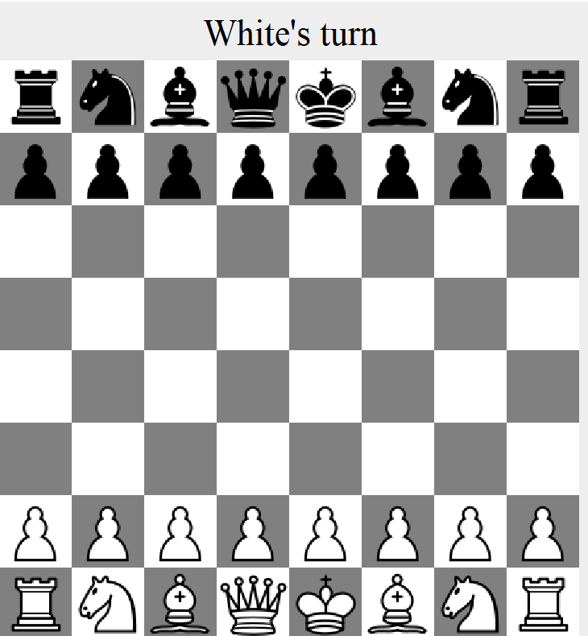
Limited Time and Space
So just to visualize that a little…
Here is the starting state of Chess, yeah?

Slide 142
Limited Time and Space
This starting State has 20 possible child states:
The 8 where any given pawn moves forward one space
The 8 where any given pawn moves forward two spaces.
The two where the “left knight” moves (up and to the left, or up and to the right).
The two where the “right knight” moves.
20 child states!

Slide 143
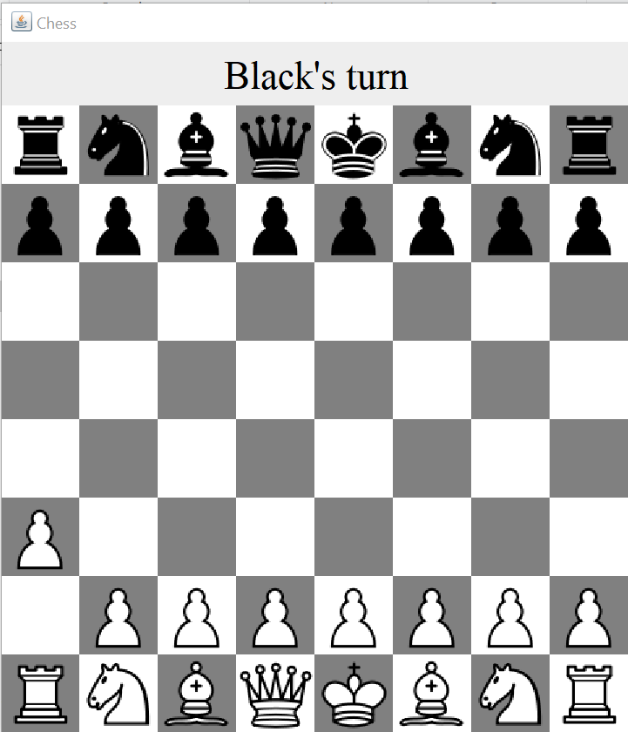
Limited Time and Space
Let’s choose one to visit: where we move the far left pawn forward one space.
This new state has 20 child states.
(The 16 “black moves a pawn” states)
(The four “black moves a knight states”)
19 other child states!

Slide 144
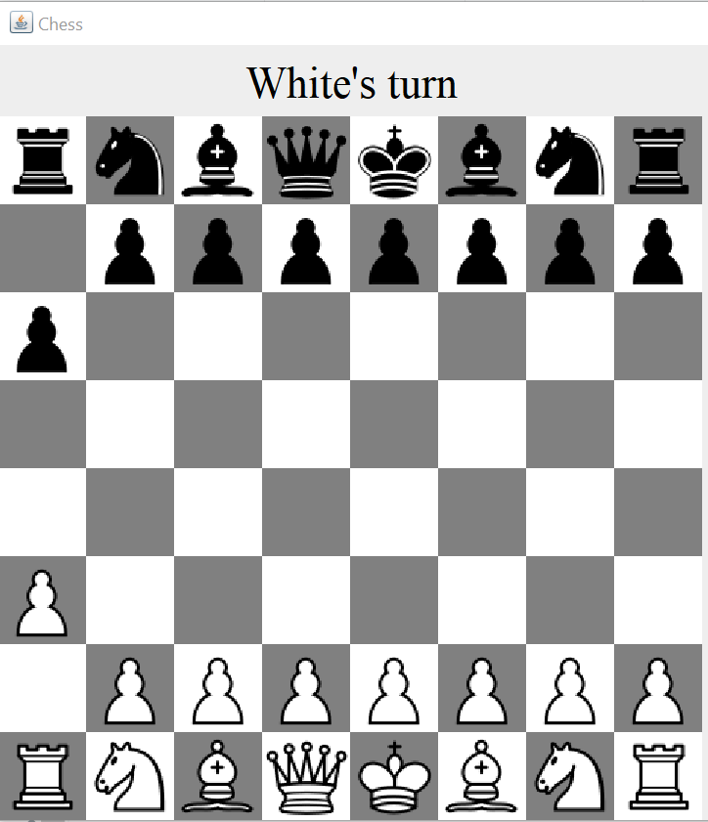
Limited Time and Space
Again, we choose one of those to visit and expand…
Black moves “far left pawn” forward one space.
19 other child states!
19 other child states!

Slide 145
Limited Time and Space
And this continues!
Technically this newest state only has 19 total children:
7 pawns have two possible moves (running total: 14)
1 pawn has 1 possible move (running total: 15)
‘Right’ knight has two possible moves (running total: 17)
‘left’ knight has one move (running total: 18)
‘left rook’ has one move (running total: 19)
19 other child states!
19 other child states!

Slide 146
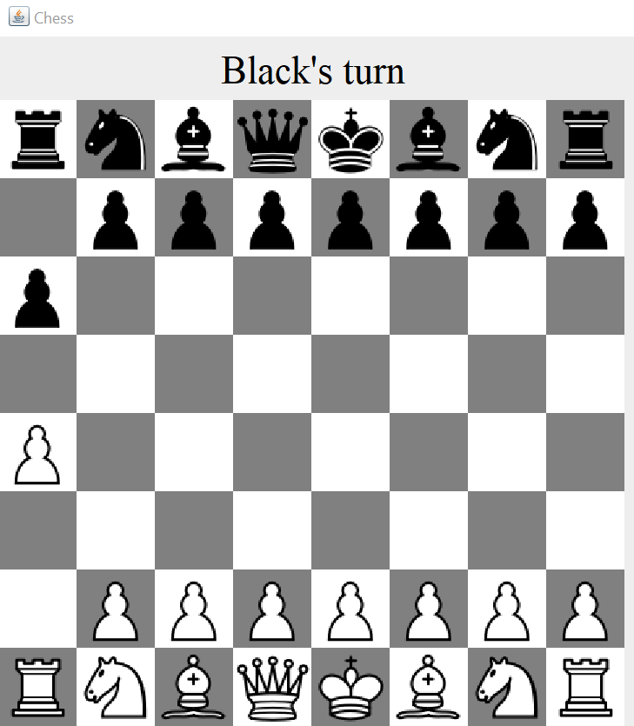
Limited Time and Space
So we choose one to expand (far let pawn moves forward one again)…
19 other child states!
19 other child states!
18 other child states!

Slide 147
Limited Time and Space
So here, the branching factor is pretty large!
And if the average game length is 40…
With each move having another ~20ish child states to consider…
You can begin to see how we hit ten duodecillion nodes
19 other child states!
19 other child states!
18 other child states!

Slide 148
Limited Time and Space
For the chess project, on any given turn you are only allowed to visit up to 500,000 states.
If you aren’t careful, you could easily exhaust this ONLY considering all possible worlds where you move a single piece.
Your bot would be blind to so many options!
19 other child states!
19 other child states!
18 other child states!

Slide 149
Limited Time and Space
So exploring the complete game tree every turn is impossible.
So to that end – the following slide is how I recommend you get started.
19 other child states!
19 other child states!
18 other child states!

Slide 150
Imperfect Decision Making.
Instead of the utility function being the “Game Theory” sense of it,
E.g., win = 1, loss = -1, stalemate = 0
You can design a utility function that evaluates the current “goodness” of a game in progress.
For example, the material score for Chess.
E.g., how many pieces you have, and of which kinds.
Instead of going all the way down to the end, you just impose an arbitrary cut-off point. E.g., “look ahead 2 ply”.
Treat those “end points” as leaves, even if they aren’t the end of the game.
No longer guaranteed to find the best strategy.
But a *much* higher chance of considering moving every piece before bumping into the search limit.

Slide 151
Imperfect Decision Making.
So to get started on the project:
Write a new method in your “MyBot” class.
It takes as input a “State” object.
And it returns as output a double (i.e., a number) representing how ‘good’ that state is.
Not sure how to figure out that number?
Step 1: Think about if you were watching two friends play chess. What would *you* look for to tell at glance who was winning?
Step 2: Research chess “Material score” on Wikipedia/the project description handout.

Slide 152
Imperfect Decision Making.
With that alone, you basically can then implement your own version of ‘greedy bot’
i.e., instead of choosing a state randomly, choose the state with the highest utility score.
Still won’t be a *great* bot, but should in theory be *a little* better.
But also, with that method in place, you can then start to implement the algorithms we talked about here…
Minimax search…
Allows you to search multiple moves ahead.
Will likely want to implement a “depth limit” so you consider more pieces.
Minimax with alpha-beta pruning
Should allow you to increase your ‘depth limit’ so you can consider even more moves ahead.

Slide 153
Iterative Deepening
We can implement the aforementioned depth limit with, iterative deepening search!
If we run out of time or space before the minimax search is finished, we can’t trust its answer.
Maybe it “ended” before it found a really, really good path.
By using iterative deepening, we start small…
E.g., first look 2 ply ahead (one move)
If we finish searching that, store the ‘best’ move found so far.
And if that succeeds without hitting our search limits, be a little bolder…
E.g., then look 4 ply ahead (two moves).
If we finish *that*, update our best move to be whatever THIS discovered.
Since we looked further into the future, so this search is taking more of our opponents options into account.
Keep increasing how far ahead we search until we reach a point where it doesn’t complete the full search.
And then use the ‘best’ move found in the previous search.

Slide 154
Imperfect Decision Making.
There’s also a new “Tic Tac Toe” example that walks you through the process of implementing minimax and minimax with alpha-beta pruning.
Another great place to start!
At this point: you are officially ready to start programming project 1!
It’s hard, but you can do it!
(And don’t be afraid to come to office hours if you need help!)
The following slides are just other bits of food for thought. You may find them helpful strategies to experiment with for defeating intermediate bot.

Slide 155
Beam Search
Limits the number of children a node can have.
For example: only consider the top five “best” children of a node, don’t bother with the rest.
This is dangerous because we might prune the best (or worst) branch.
i.e., we are hoping that “short term ‘goodness’” is indicative of long-term ‘goodness.’
But that’s not necessarily the case!

Slide 156
Move Ordering
In our previous examples, we just picked Actions at random, and went down the list.
BUT – if we have a hunch as to what Actions are *likely* to be best and worst, we can *start* with those.
If early actions establish wild swings in Utility values, i.e., discovers very high and very low alpha and beta values sooner…
Then the sooner we can start pruning other nodes that don’t compare.
For example, in Chess, you might consider moves which capture pieces first. These are likely to lead to more extreme utility values and thus improve pruning.

Slide 157
Horizon Problem
You are in a bad situation…
You can delay the bad situation by making “less bad” short-term moves…
BUT – those delaying tactics don’t actually help you, and you just end up in a worse spot than you were before!

Slide 158
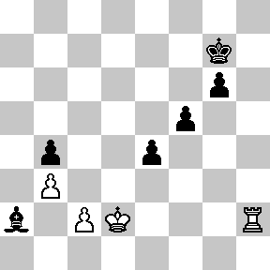
Horizon Problem
Material Score:
White: 7 (1 + 1 + 5)
Black: 7 (1 + 1 + 1 + 1 +3)
Black’s Turn to Move.
Black Looks two moves ahead.
Can see that the bishop is in trouble.
If lost, black’s score drops to 4.
Notes:
The move that maximizes black’s material score is to have the bishop take the pawn, but that puts black in a bad position (the bishop will be in danger), resulting in white ultimately having a score of 6, but black a score of 4.

Slide 159
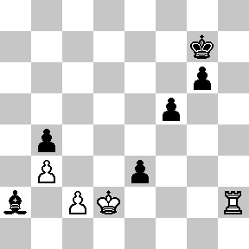
Horizon Problem
Material Score:
White: 7 (1 + 1 + 5)
Black: 7 (1 + 1 + 1 + 1 +3)
So Black moves this pawn over here, figuring that white will be excited to take it (and placing the king in check)…

Slide 160
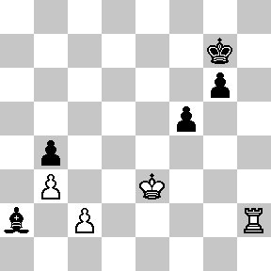
Horizon Problem
Material Score:
White: 7 (1 + 1 + 5)
Black: 6 (1 + 1 + 1 +3)
White *is* excited to take it, and the material score of black only went down to 6, not 4, so Black is happy too! Black found the “max” score!
BUT, the bishop is still in danger of being caught within two turns.

Slide 161
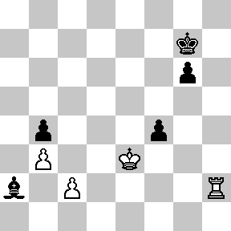
Horizon Problem
Material Score:
White: 7 (1 + 1 + 5)
Black: 6 (1 + 1 + 1 +3)
So black bravely moves its pawn…

Slide 162
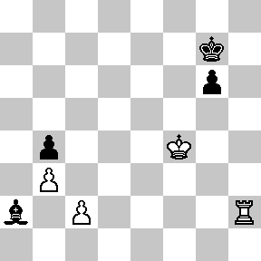
Horizon Problem
Material Score:
White: 7 (1 + 1 + 5)
Black: 5 (1 + 1 +3)
And white, again, takes it.
Black is kind of happy – the score is 5, instead of 3. But the score is still going down, and Black’s position isn’t getting better (it’s getting worse)
This is a hard problem to figure out!
Notes:
The idea being that in order to avoid doom (losing the bishop) you make short-term sacrifices, but those short-term sacrifices aren’t actually addressing the original problem, they are just delaying it because that original problem still happens, just further ahead than where you were looking!

Slide 163
Quiescence
One issue with just arbitrarily cutting things off (e.g., just saying “the depth limit is 4 ply)
If the next move is really good, or really bad, we won’t see it.
e.g. maybe at 5 ply the enemy could make a move that puts us in check-mate!
It’s a complete mystery to us.
Quiescence search places some values on “quiet” moves.
Moves that *aren’t* likely to demonstrate wild swings in utility in the near future.
E.g., Only cut off the search if we have reached the max-depth limit AND the game is in a relative state of equilibrium (e.g., the next moves are not “big ones”).
In Chess: do an extra “quiescence search” after reaching max depth for non-quiescent nodes.
Sometimes quiescence search is limited to certain types of actions, e.g., capture actions, with the thought being that it will resolve the uncertainty quickly.
Notes:
When we say “arbitrarily cutting things off” – we mean only looking ahead X moves – we can only make the best choice up to what we see – even if it turns out that one more ply could be devastating for us.

